Slide 1
How to Excel in R

Slide 2
NACRE Fish Visual Census Data
15,000 ++ lines
Large amount of data - 1 line has Species, Biogeographic Region, Biomass, Trophic Group
MS Excel used to do Pivot Tables >> Prone to mistakes

Slide 3
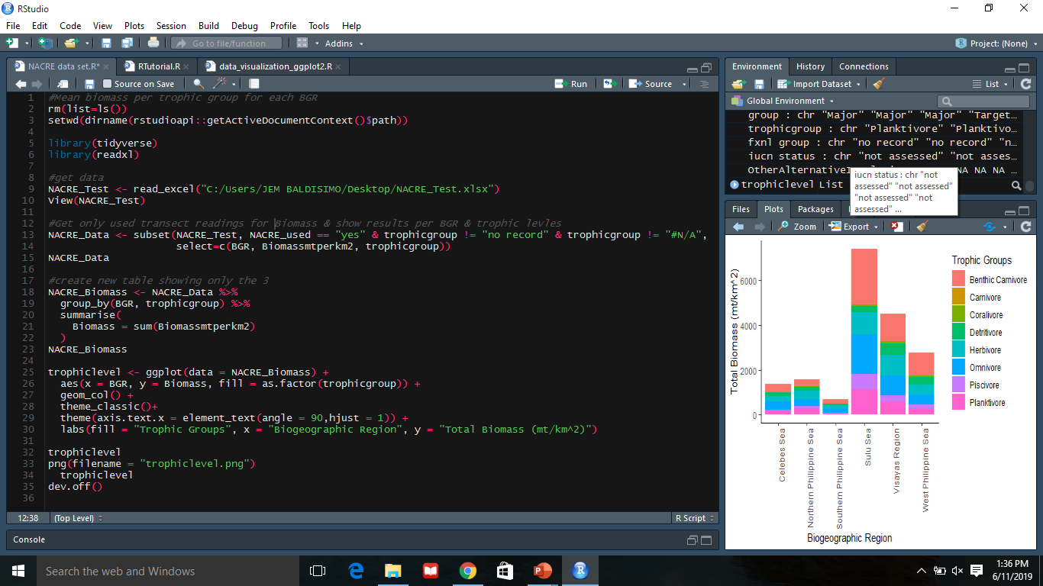

Slide 4
